Slide 1


TIAGO VITALI
23/07/2023

Slide 2

Outline
Executive Summary
Introduction
Methodology
Results
Conclusion
Appendix

Slide 3
Executive Summary
Summary of methodologies
Data Collection: API and Webscraping with BeautifulSoup;
Data Wrangling: Dealing with missing values in the columns ‘’ through ?? and ‘’ through ??, created a landing outcome label from Outcome column;
Exploratory Data Analysis: Data analyzed with SQL, pandas and matplotlib
Summary of all results

Slide 4
Introduction
SpaceX advertises Falcon 9 rocket launches on its website with a cost of 62 million dollars whereas other providers cost upward of 165 million dollars each, much of the savings is because Space X can reuse the first stage.
Therefore, if we can determine if the first stage will land, we can determine the cost of a launch.
This information can be used if an alternate company wants to bid against SpaceX for a rocket launch.

Slide 5

Section 1

Slide 6
Methodology
Executive Summary
Data collection methodology:
Describe how data was collected
Perform data wrangling
Describe how data was processed
Perform exploratory data analysis (EDA) using visualization and SQL
Perform interactive visual analytics using Folium and Plotly Dash
Perform predictive analysis using classification models
How to build, tune, evaluate classification models

Slide 7
Data Collection
Describe how data sets were collected.
You need to present your data collection process use key phrases and flowcharts

Slide 8
Data Collection – SpaceX API
Present your data collection with SpaceX REST calls using key phrases and flowcharts
Add the GitHub URL of the completed SpaceX API calls notebook (must include completed code cell and outcome cell), as an external reference and peer-review purpose
Place your flowchart of SpaceX API calls here

Slide 9
Data Collection - Scraping
Present your web scraping process using key phrases and flowcharts
Add the GitHub URL of the completed web scraping notebook, as an external reference and peer-review purpose
Place your flowchart of web scraping here

Slide 10
Data Wrangling
Describe how data were processed
You need to present your data wrangling process using key phrases and flowcharts
Add the GitHub URL of your completed data wrangling related notebooks, as an external reference and peer-review purpose

Slide 11
EDA with Data Visualization
Summarize what charts were plotted and why you used those charts
Add the GitHub URL of your completed EDA with data visualization notebook, as an external reference and peer-review purpose

Slide 12
EDA with SQL
Using bullet point format, summarize the SQL queries you performed
Add the GitHub URL of your completed EDA with SQL notebook, as an external reference and peer-review purpose

Slide 13
Build an Interactive Map with Folium
Summarize what map objects such as markers, circles, lines, etc. you created and added to a folium map
Explain why you added those objects
Add the GitHub URL of your completed interactive map with Folium map, as an external reference and peer-review purpose

Slide 14
Build a Dashboard with Plotly Dash
Summarize what plots/graphs and interactions you have added to a dashboard
Explain why you added those plots and interactions
Add the GitHub URL of your completed Plotly Dash lab, as an external reference and peer-review purpose

Slide 15
Predictive Analysis (Classification)
Summarize how you built, evaluated, improved, and found the best performing classification model
You need present your model development process using key phrases and flowchart
Add the GitHub URL of your completed predictive analysis lab, as an external reference and peer-review purpose

Slide 16
Results
Exploratory data analysis results
Interactive analytics demo in screenshots
Predictive analysis results

Slide 17

Section 2

Slide 18
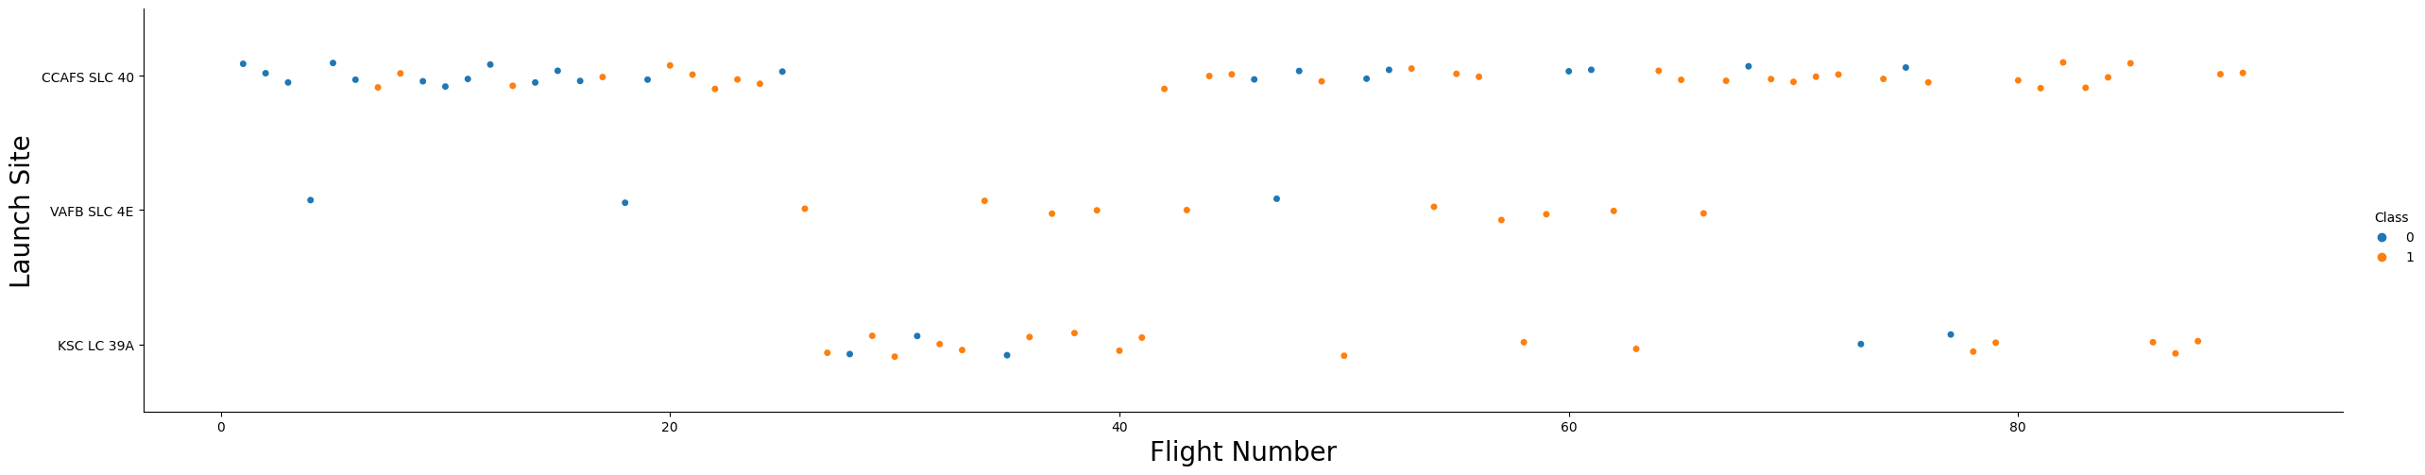
Flight Number vs. Launch Site
Here we can see the screenshot of the scatter plot Flight Number X Launch Site.
We can observe that almost all the first 25 flights were launched from base CCAFS SLC 40 and that all the last 11 flights succeeded in landing the first stage.

Slide 19
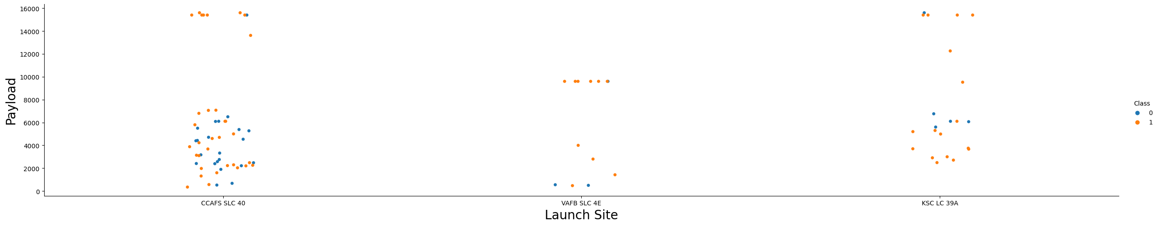
Payload vs. Launch Site
In this plot of Payload vs. Launch Site we can observe that the launch site VAFB SLC 4E seems to have a maximum payload of 10000 Kg while CCAFS SLC 40 and KSC LC 39A seem to have this value in 16000 Kg.

Slide 20
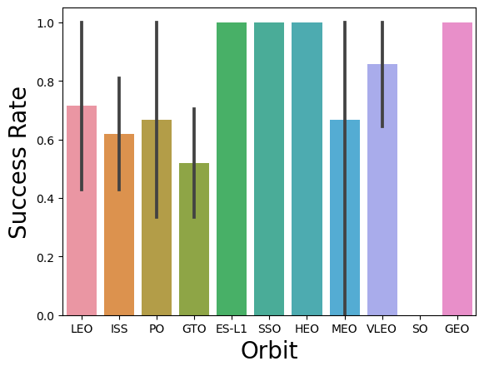
Success Rate vs. Orbit Type
In this graph we can see 4 bars without error bars in it. It means that they had only one flight, or all flights had the same outcome. In the next slide we can see that the first option is true.
We can also observe that the orbit with higher success rate was VLEO.

Slide 21
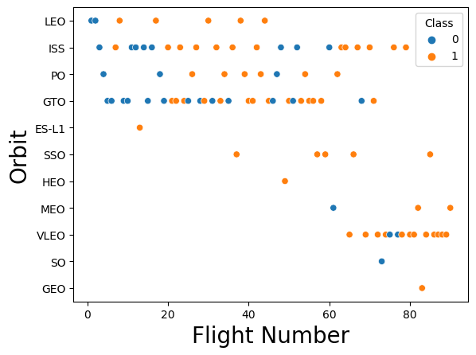
Flight Number vs. Orbit Type
In this graph we can see that the orbits with more flights are GTO, ISS, PO and VLEO.
We can also see that the last flights were more concentrate in the ISS and VLEO orbits.

Slide 22
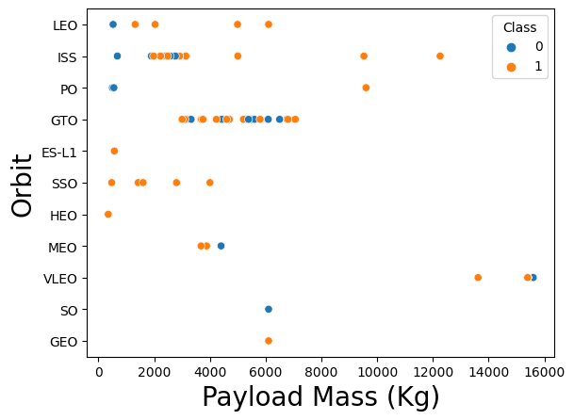
Payload vs. Orbit Type
In this graph we can see that with heavy payloads the successful landing or positive landing rate are more for Polar, LEO and ISS.
We can also observe that GTO orbit between 3000Kg and 7000Kg, and VLEO orbit, the most successful one, had more concentrated payloads.

Slide 23
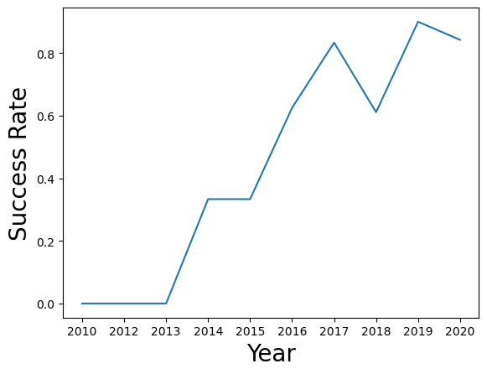
Launch Success Yearly Trend
With this graph we can observe that the success rate kept increasing since 2013 until 2020;

Slide 24
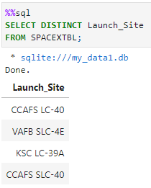
All Launch Site Names
Were found a total of 4 launch sites;

Slide 25
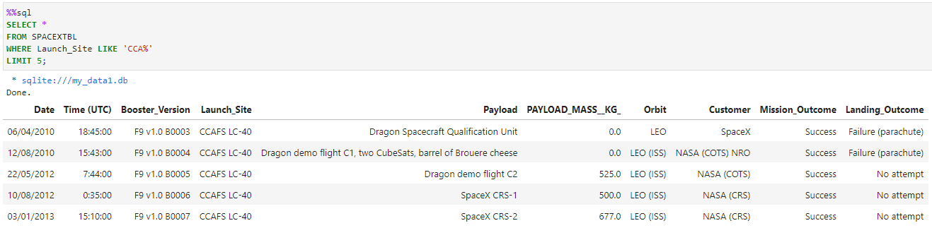
Launch Site Names Begin with 'CCA'
Here we can see 5 records where launch sites begin with `CCA`;

Slide 26
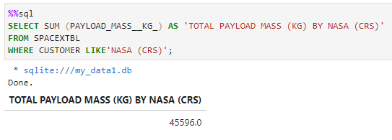
Total Payload Mass
Here we can see the total payload mass (Kg) carried by boosters from NASA;

Slide 27
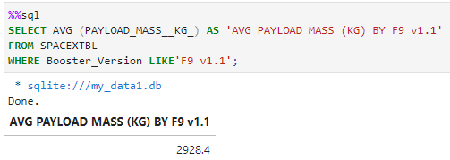
Average Payload Mass by F9 v1.1
Here we can see the average payload mass carried by booster version F9 v1.1

Slide 28
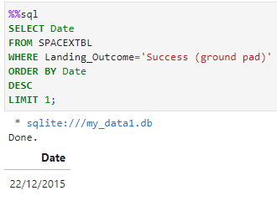
First Successful Ground Landing Date
Here we can see the date of the first successful landing outcome on ground pad.

Slide 29
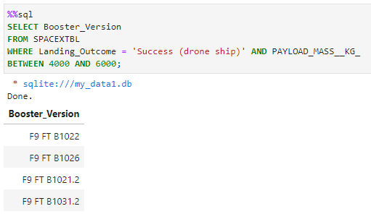
Successful Drone Ship Landing with Payload between 4000 and 6000
Here we can see the list the names of boosters which have successfully landed on drone ship and had payload mass greater than 4000 but less than 6000.

Slide 30
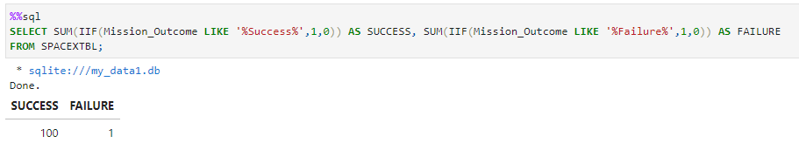
Total Number of Successful and Failure Mission Outcomes
Here we can see the total number of successful and failure mission outcomes.

Slide 31
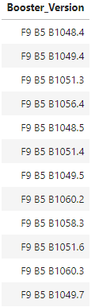
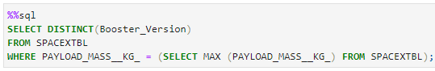
Boosters Carried Maximum Payload
Here we can see a list with the names of the booster which have carried the maximum payload mass.

Slide 32
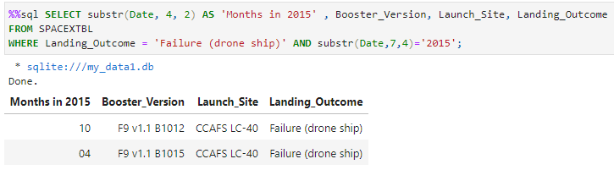
2015 Launch Records
Here we can see a list of the failed landing outcomes in drone ship, their booster versions, and launch site names for in year 2015.

Slide 33
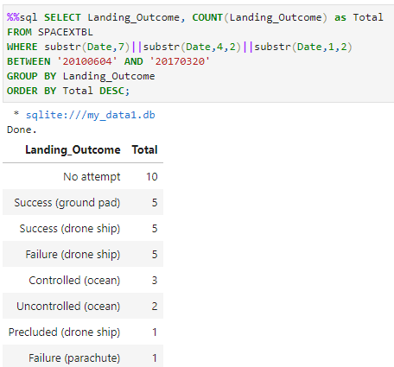
Rank Landing Outcomes Between 2010-06-04 and 2017-03-20
Here we can see the rank of landing outcomes (such as Failure (drone ship) or Success (ground pad)) between the date 2010-06-04 and 2017-03-20, in descending order.

Slide 34

Section 3

Slide 35
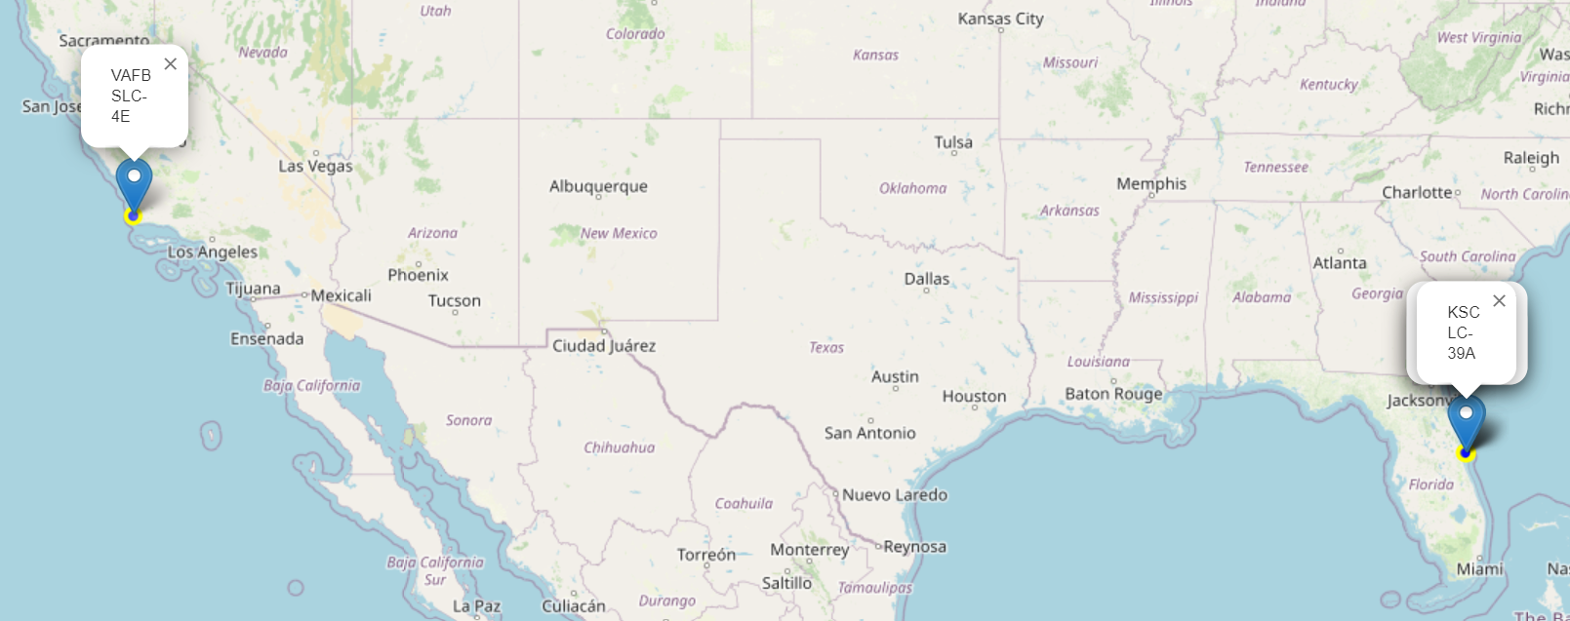
Folium Map Site Locations
From this map we can see that we have launch sites in opposite sides of the USA and near to the sea;

Slide 36
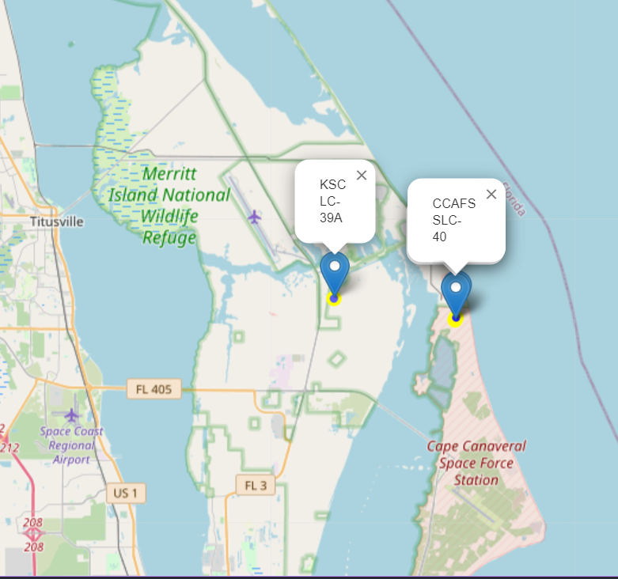
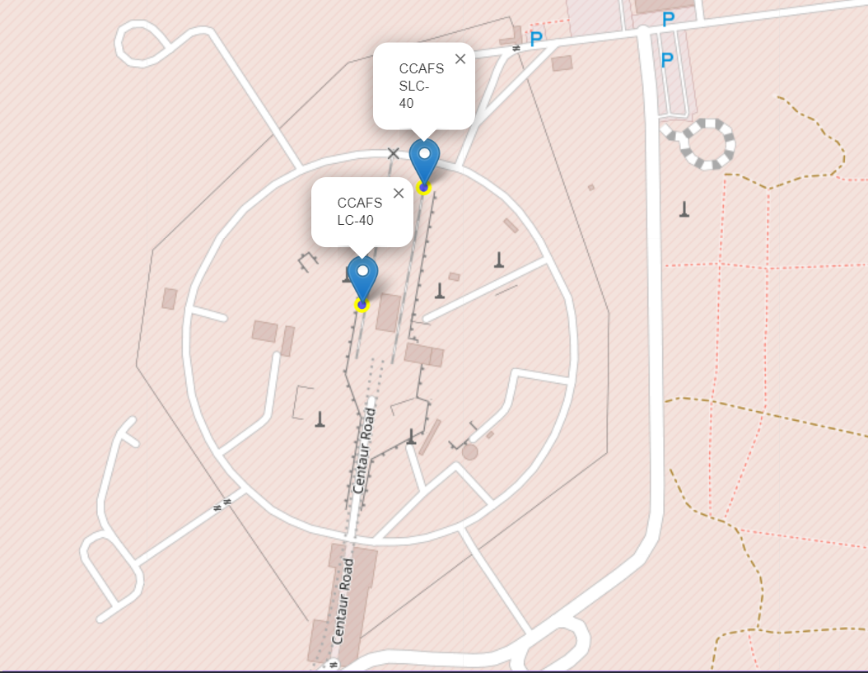
Folium Map Site Locations

Slide 37
Folium Map Site Locations
From the previous maps we can see that there are 3 launch bases in Cape Canaveral;

Slide 38
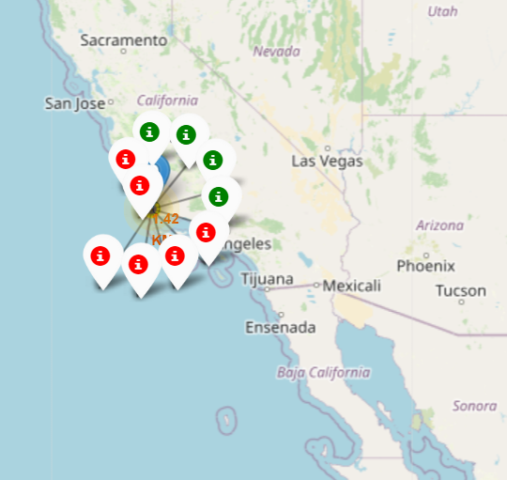
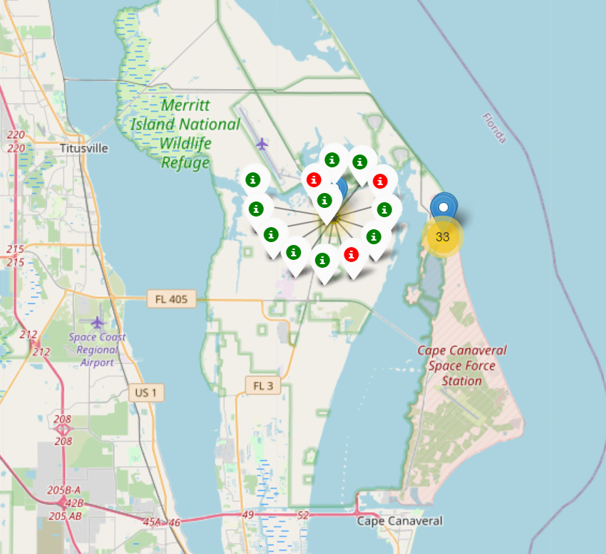
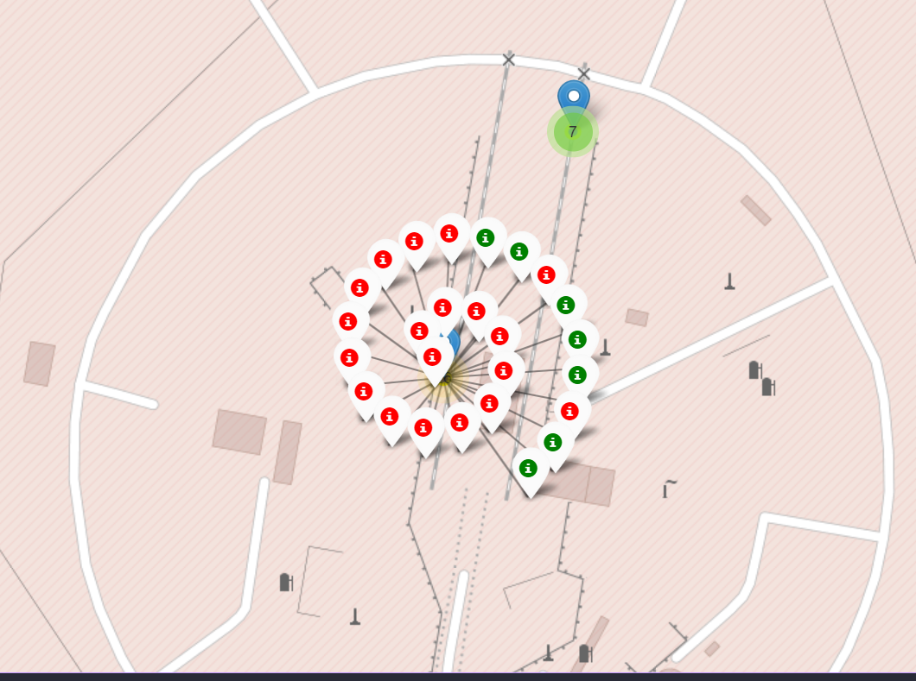
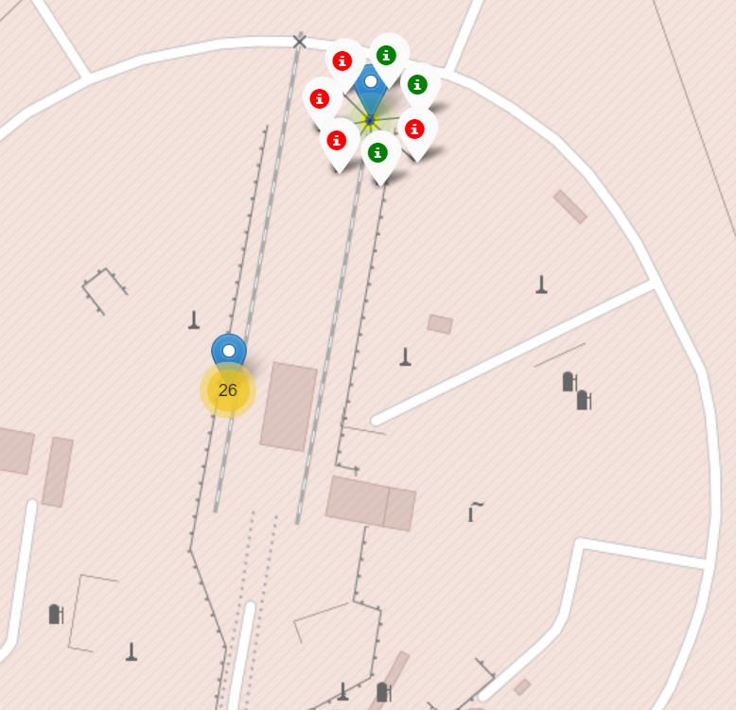
Launch Outcomes By Bases

Slide 39
Launch Outcomes By Bases
From the previous maps we can observe that the base KSC LC-39A had the higher outcome success rate while the base CCAFS LC-40 had the lower;

Slide 40
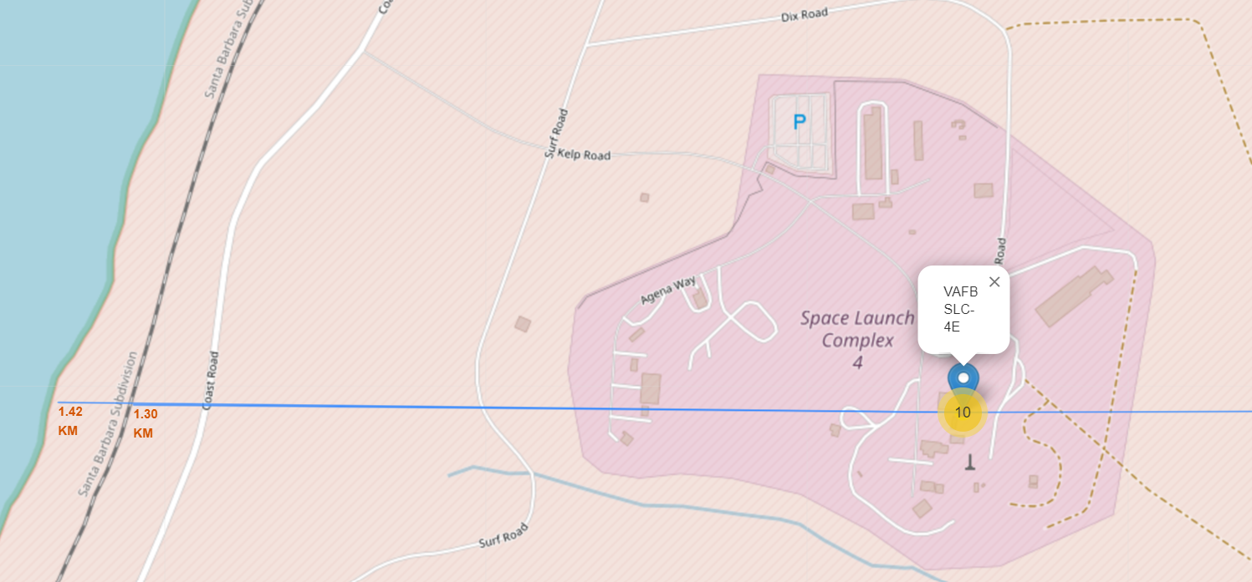
Base Launch Distance To Its Proximities

Slide 41
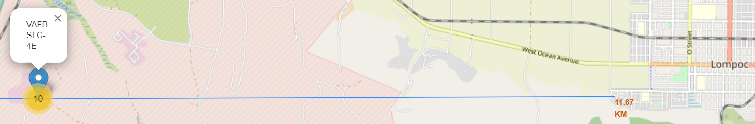
Base Launch Distance To Its Proximities
From the previous maps we can observe that the launch base VAFB SLC-4E it’s 1.42Km far from the coast, 1.30Km far from the nearest railway and 11.67Km far from the nearest city.

Slide 42

Section 4

Slide 43
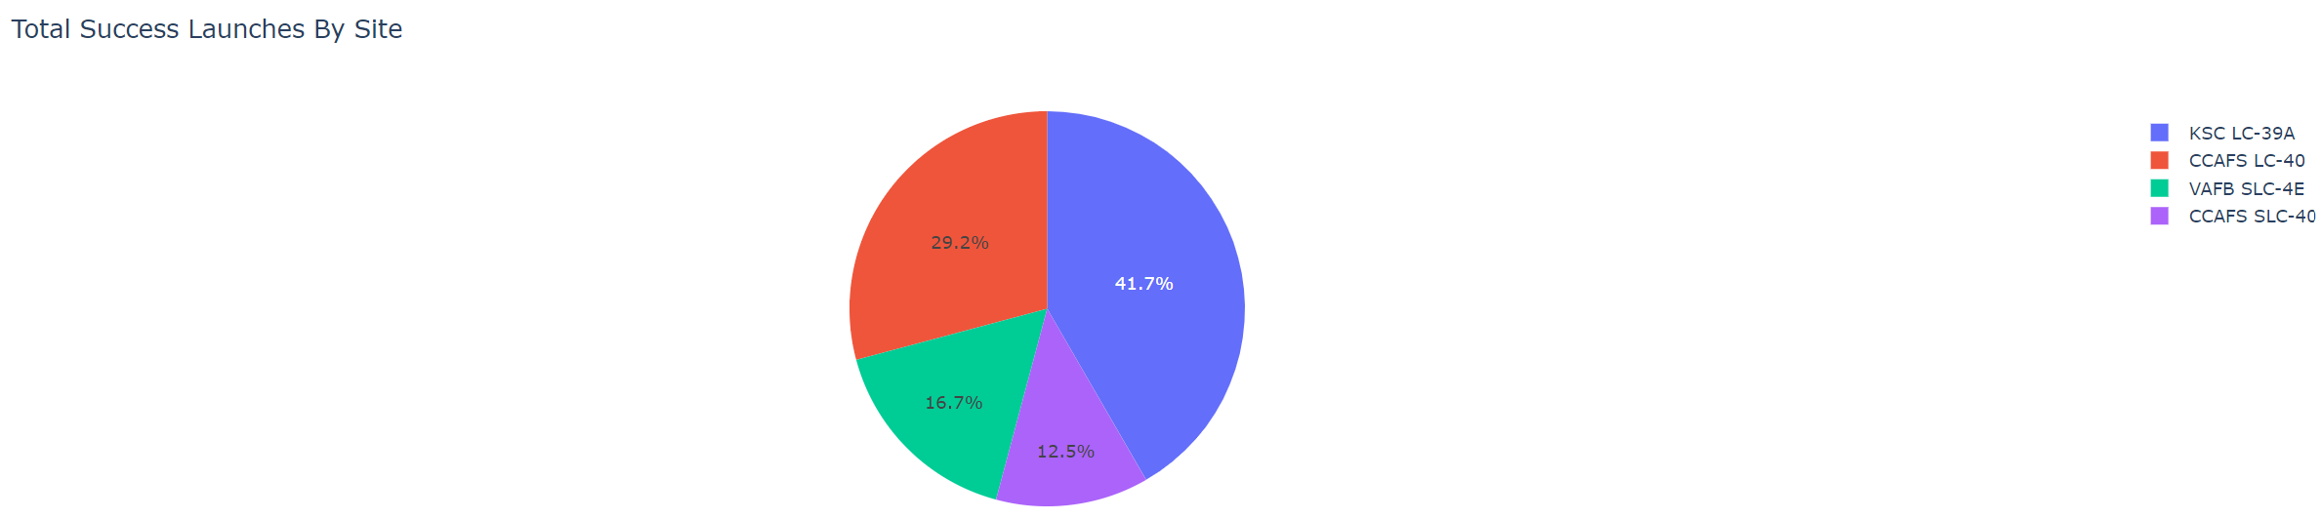
Total Success Launches By Site
With this graph we can see that, of the total number of launches that successfully landed, most of them, 41.7%, took off from the KSC LC-39A base, followed by 29.2% from the CCAFS LC-40.

Slide 44
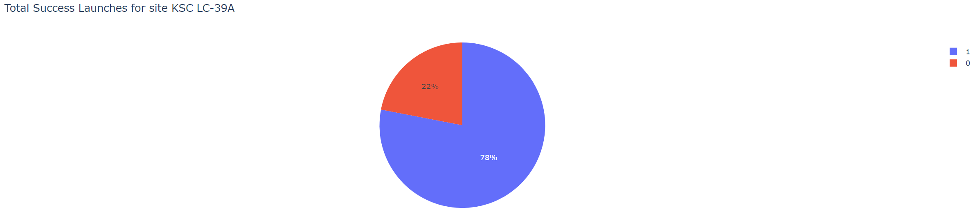
Launch Site With Highest Launch Success
With this graph we can observe that the site with the highest launch success rate had 78% of successful flights.

Slide 45
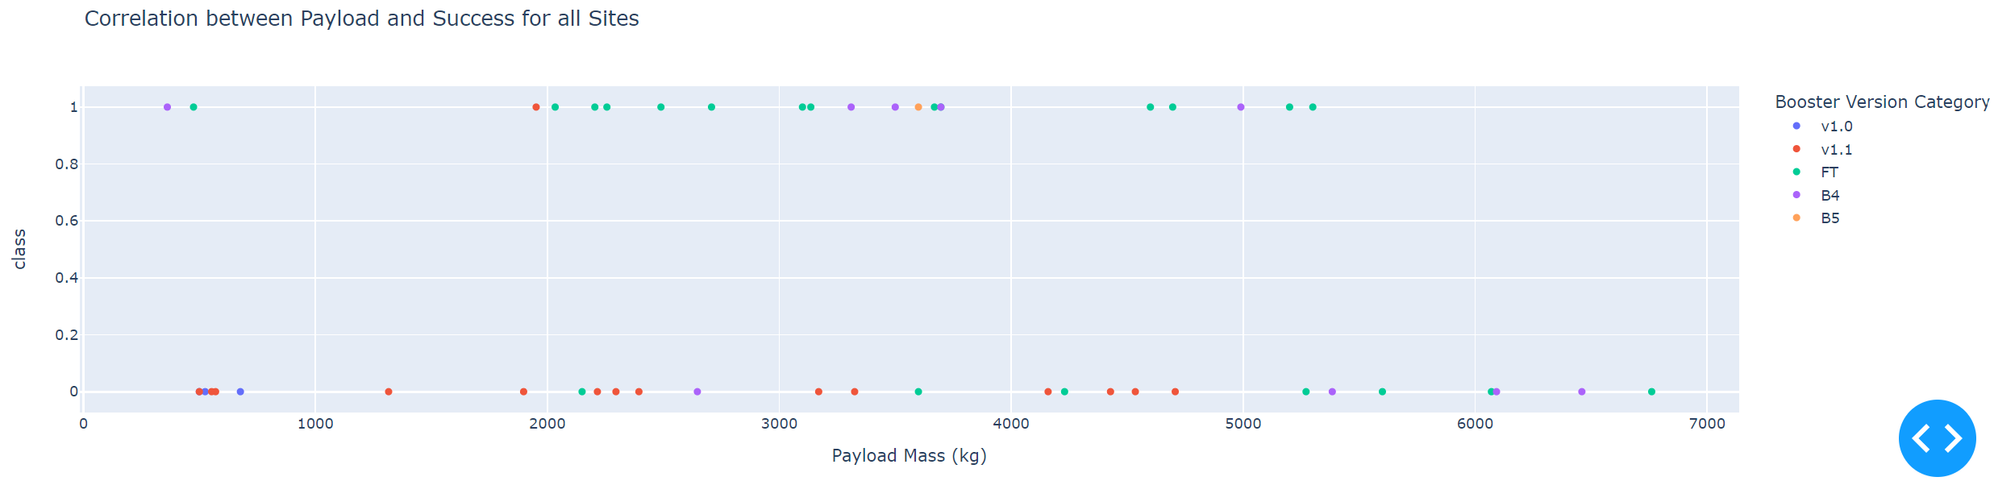
Correlation Between Payload and Success
With this graph we can observe that the payload range between 3000 and 4000Kg had the largest success rate;
We can also see that the booster version FT had the largest success rate while the v1.1 the smaller;

Slide 46

Section 5

Slide 47
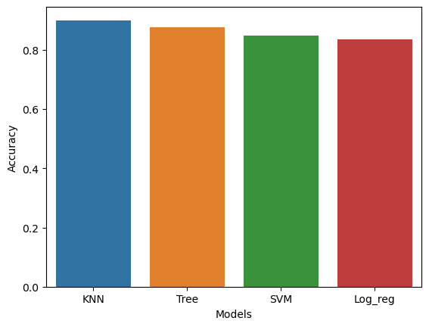
Classification Accuracy
According with this graph we can see that the model with highest accuracy is KNN;

Slide 48
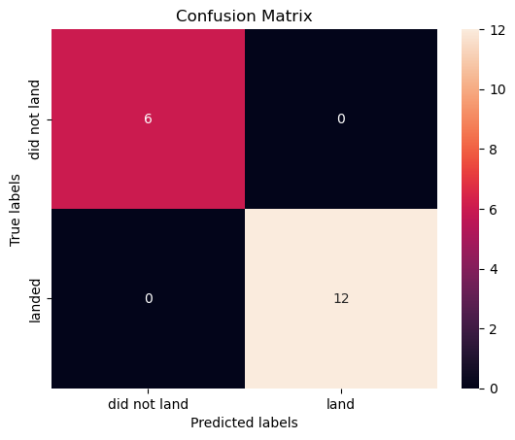
Confusion Matrix
The confusion matrix for the KNN model show us that we don’t have false positives or false negatives, that is, the model correctly classified all the test sample.

Slide 49
Conclusions
Point 1
Point 2
Point 3
Point 4
…

Slide 50
Appendix
Include any relevant assets like Python code snippets, SQL queries, charts, Notebook outputs, or data sets that you may have created during this project

Slide 51


